Slide 1



Robotic Gastric By-pass: Pro & Cons
M. Anselmino, MD, Ph D, FASMBS
Chair in Bariatric & Metabolic Surgery
IRCCS San Raffaele Scientific Institute
Milano, Italy

Slide 2


Robotic Gastric By-pass: Pro & Cons
Why shifting from laparoscopic to robotics
Restricted motion of laparoscopic instruments
Hepatomegaly
Reduced dexterity and poorer ergonomics
Significant surgeon’s musculo-skeletal stress
Cons
Robotic
Three-dimensional view facilitates fine tissue dissection
Downscaling the surgeon’s movements
Increases dexterity and better ergonomics
Shorter learning curve
Pro

Slide 3
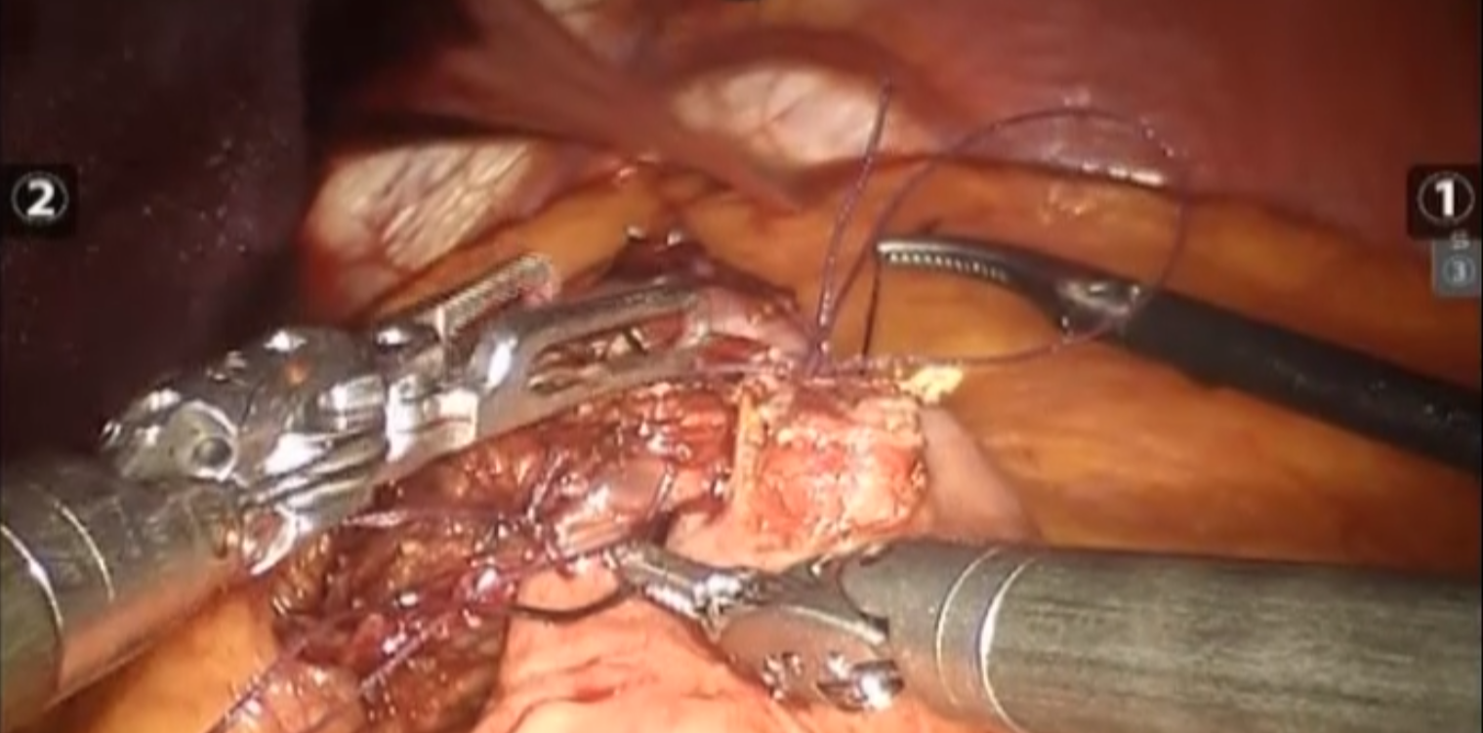
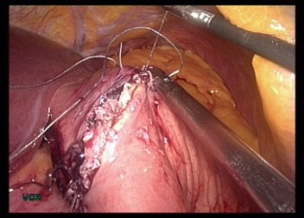
Robotic Gastric By-pass
Pro & Cons
ROBOTIC VS LAPAROSCOPIC OUTCOME

Slide 4
Personal Experience
Primary Lap vs. Lap Revisional vs. Robotic RYGBP
Complications
Complications | Primary RYGBP (n=946) | p Value | Revisional RYGBP (n=105) | Totally Robotic RYGBP (n=17) | p Value | Robotic-assisted RYGBP (n=77)
Leaks | 12 (1.26%) | <0.001 | 6 (5.71%) | 0 | n.s | 0
Bleeding | 8 (0.9%) | n.s. | 1 (0.95%) | 1 (5.2%) | n.s | 1 (1.3%)
Anastomotic strictures | 17 (1.79%) | n.s. | 3 (2.85%) | 0 | n.s. | 1 (1.3%)
Marginal ulcers | 9 (0.95%) | n.s. | 3 (2.85%) | 0 | n.s. | 0
Internal hernias | 6 (0.63%) | n.s. | 2 (1.90%) | 0 | n.s. | 0
TOTAL | 52 (5.49%) | <0.001 | 15 (14.2%) | 1 (5.2%) | n.s. | 2 (2.6%)
Conversions | 33 (3.4%) | <0.01 | 25 (23.8%) | 0 | n.s. | 0
Mortality | 3 (0.31%)* | <0.01 | 1 (0.95%) | 0 | n.s. | 0
* 2 P.E.

Slide 5
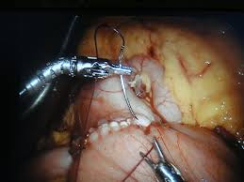
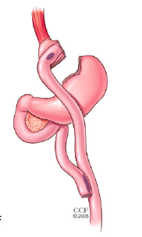
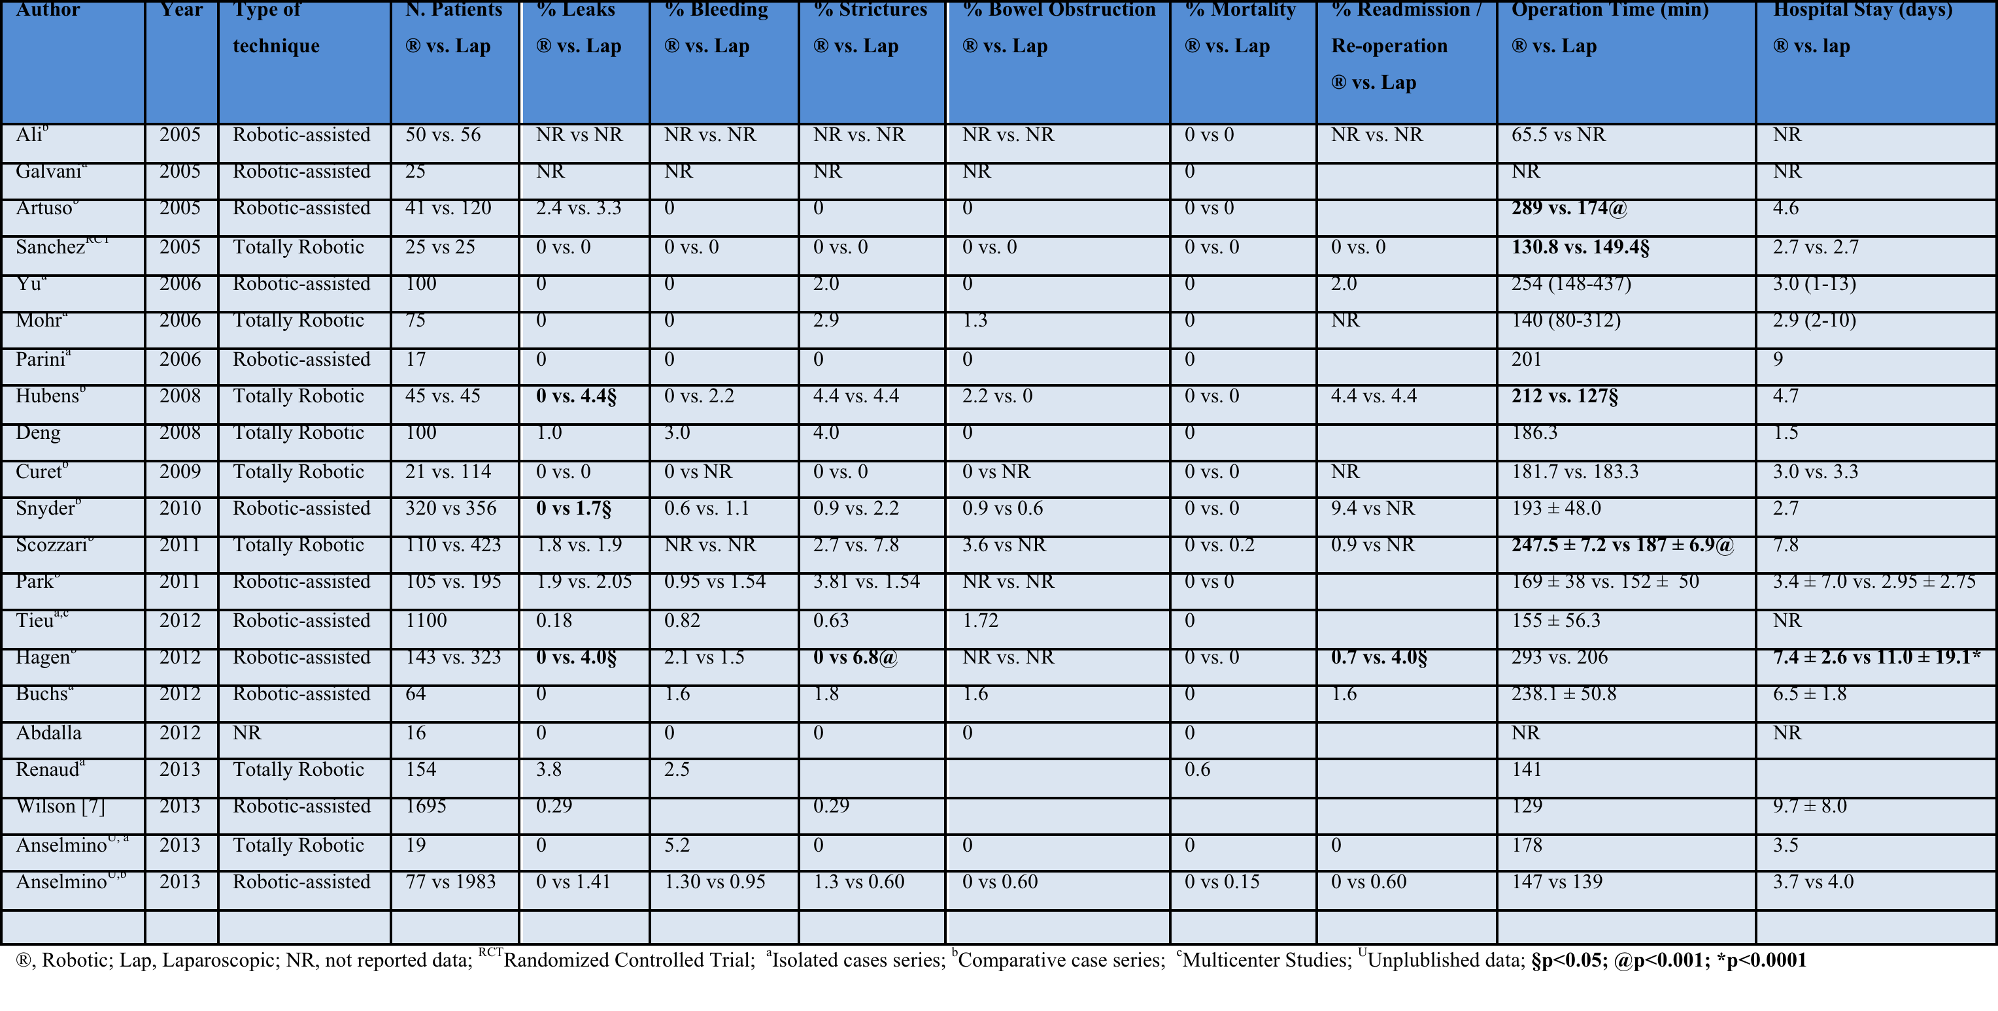
2013
Totally Robotic / Robotic-assisted
vs.
Laparoscopic Roux-en-Y Gastric Bypass
Morbidity, Mortality, OT and LoS
No considerable difference in morbidity and mortality rate and hospital readmission
Longer Operating Time

Slide 6
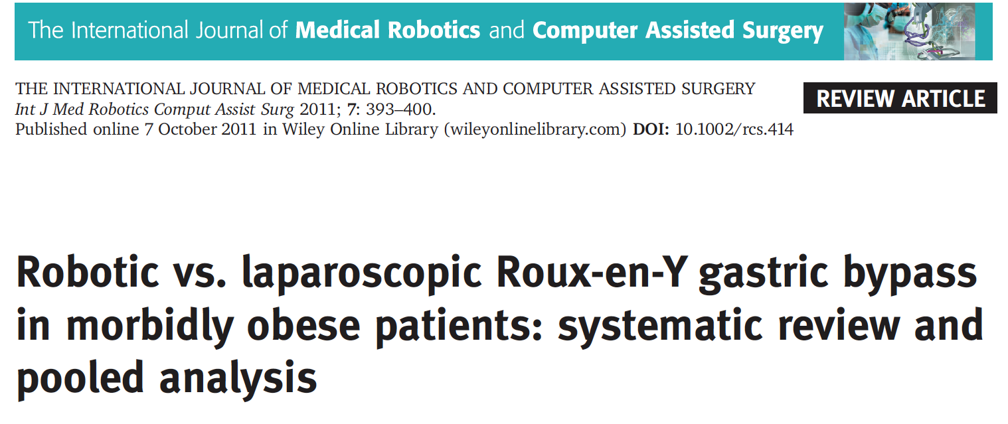
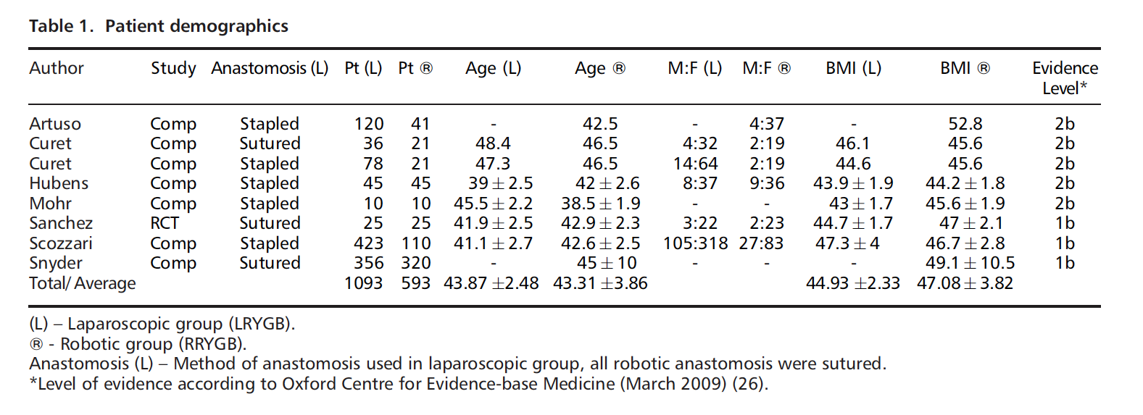
2011

Slide 7
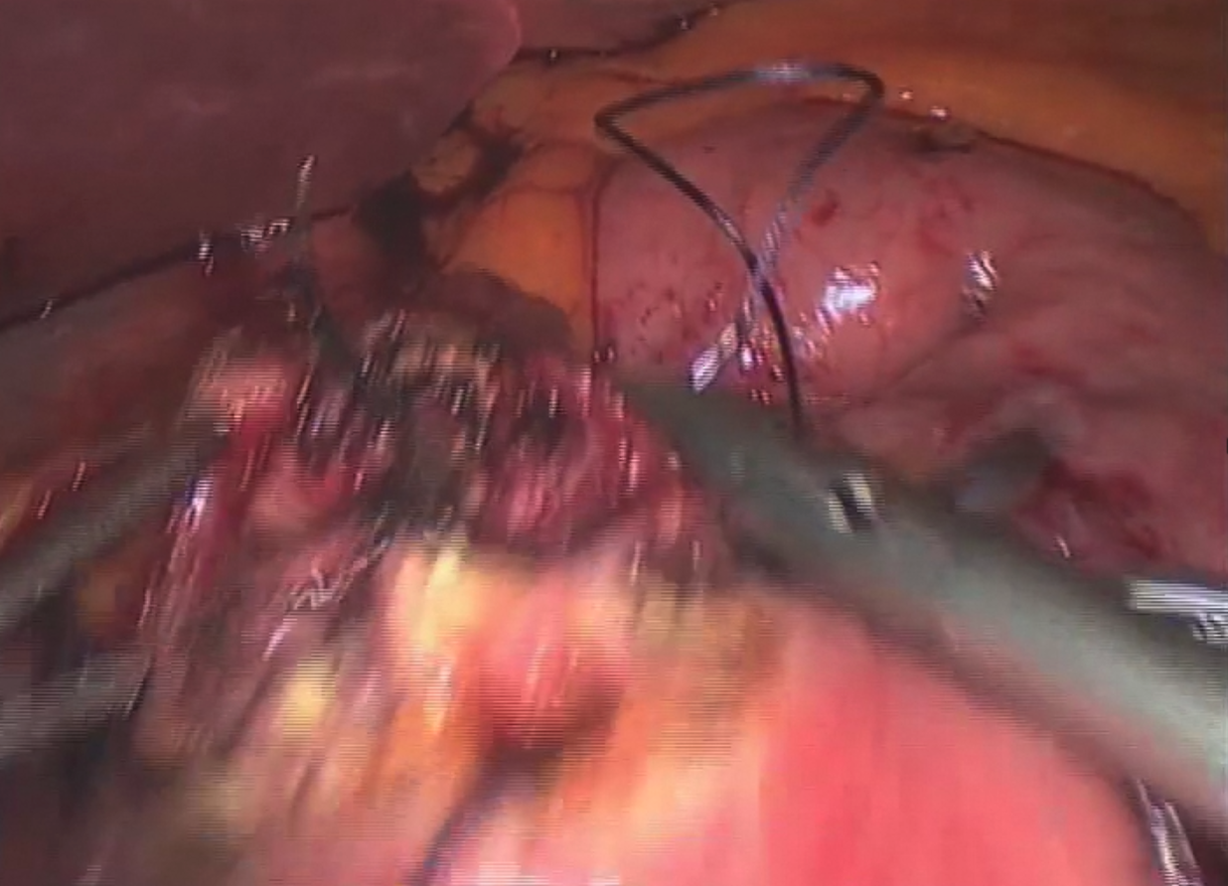
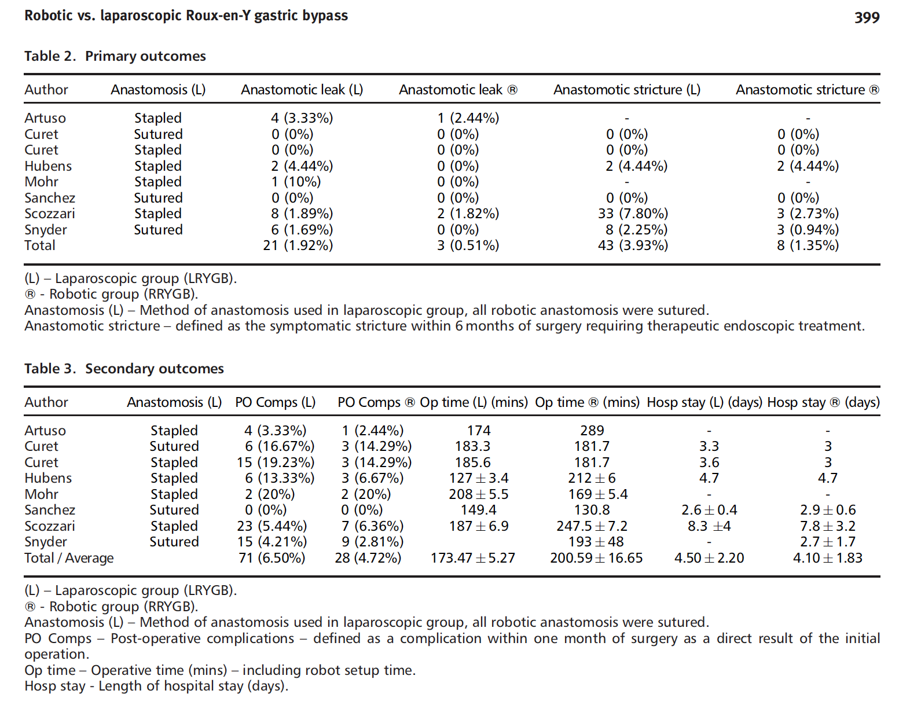

Slide 8
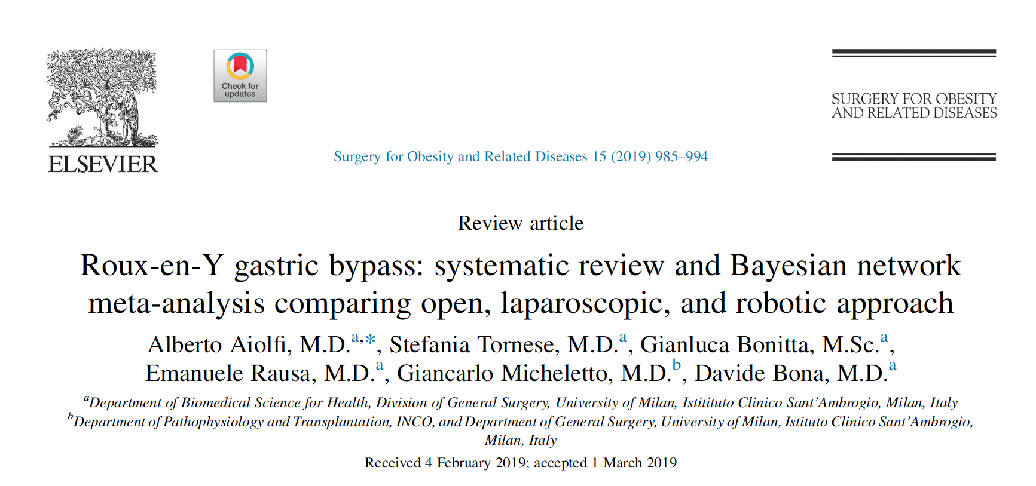
2019
19 studies
2 multicenter
No RCT
276.732 patients:
- 79.706 (28.8%) Open RYGBP
- 186.399 (67.3%) Laparoscopic RYGBP
- 10.627 (3.9%) Robotic RYGBP

Slide 9
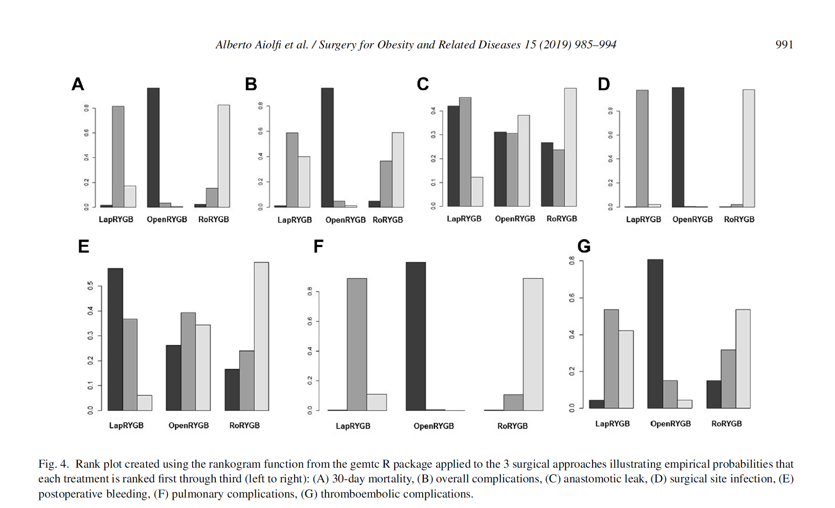

Slide 10
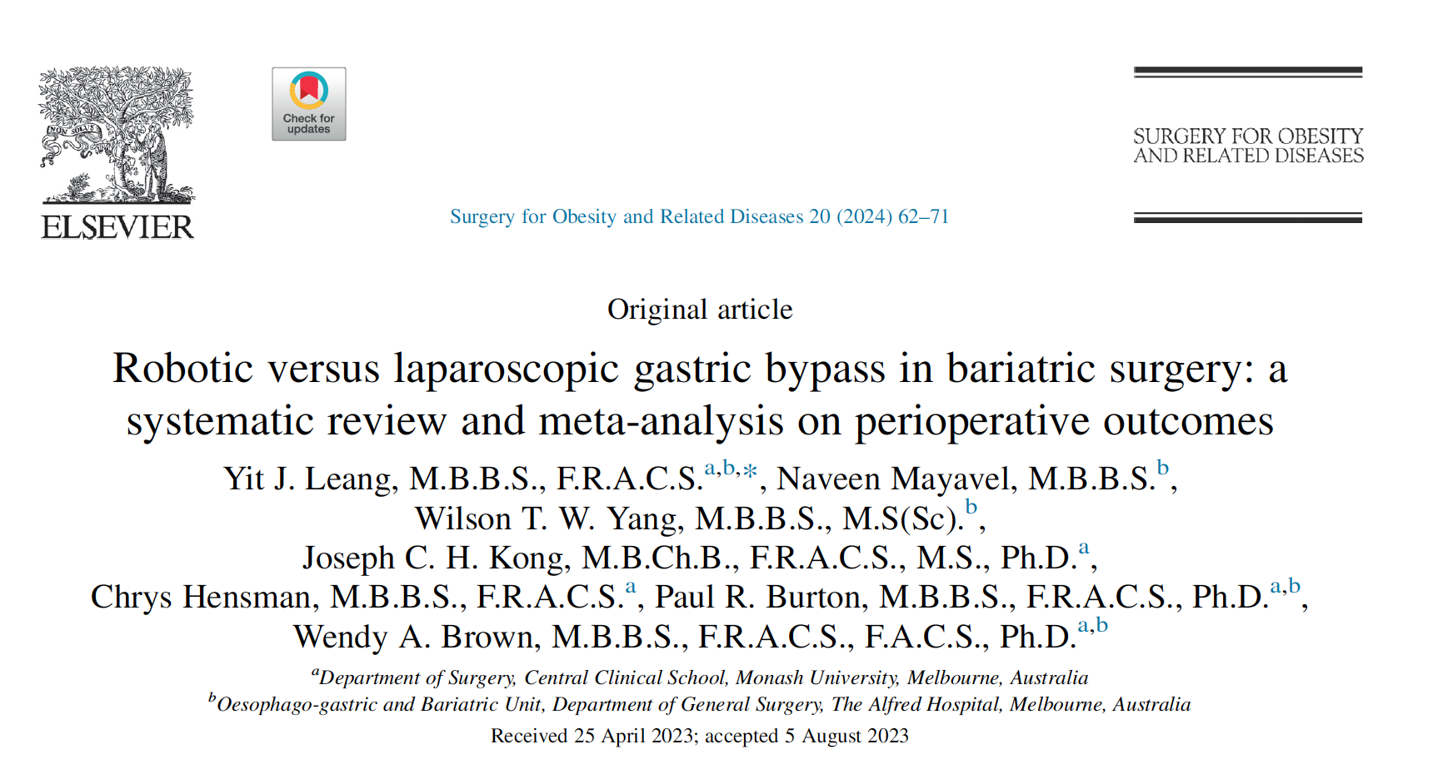
2024
28 studies
4 multicenter
1 RCT
1 Prospective
26 Retrospective
82.155 patients:
- 73.104 (89%) Laparoscopic RYGBP
- 9.051 (11%) Robotic RYGBP

Slide 11
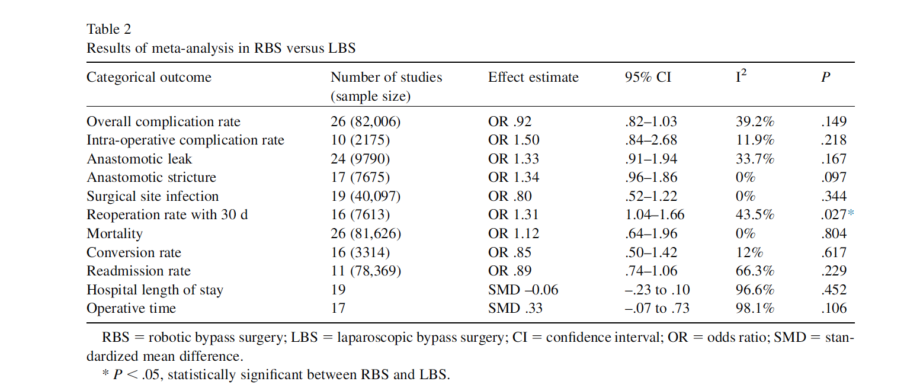

Slide 12
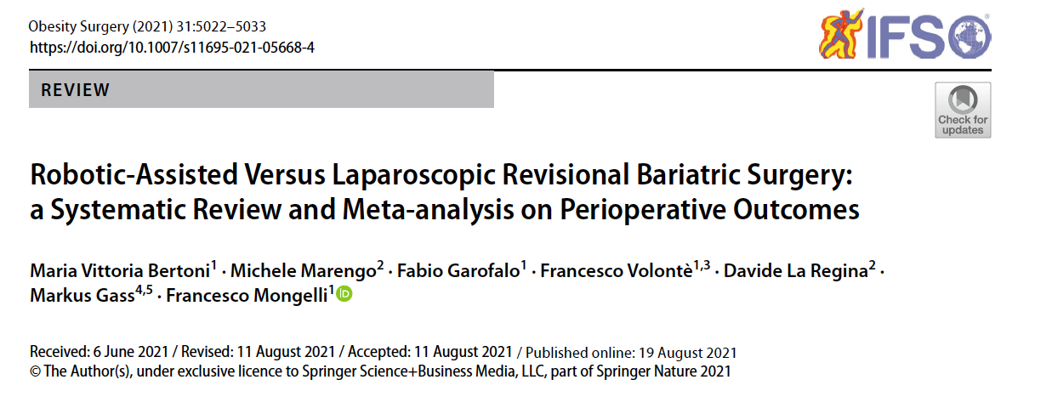
2021
6 studies
no RCT
no Prospective
6 Retrospective
29.890 patients:
- 27.431 (91.7%) Laparoscopic RYGBP
- 2.459 (8.3%) Robotic RYGBP

Slide 13
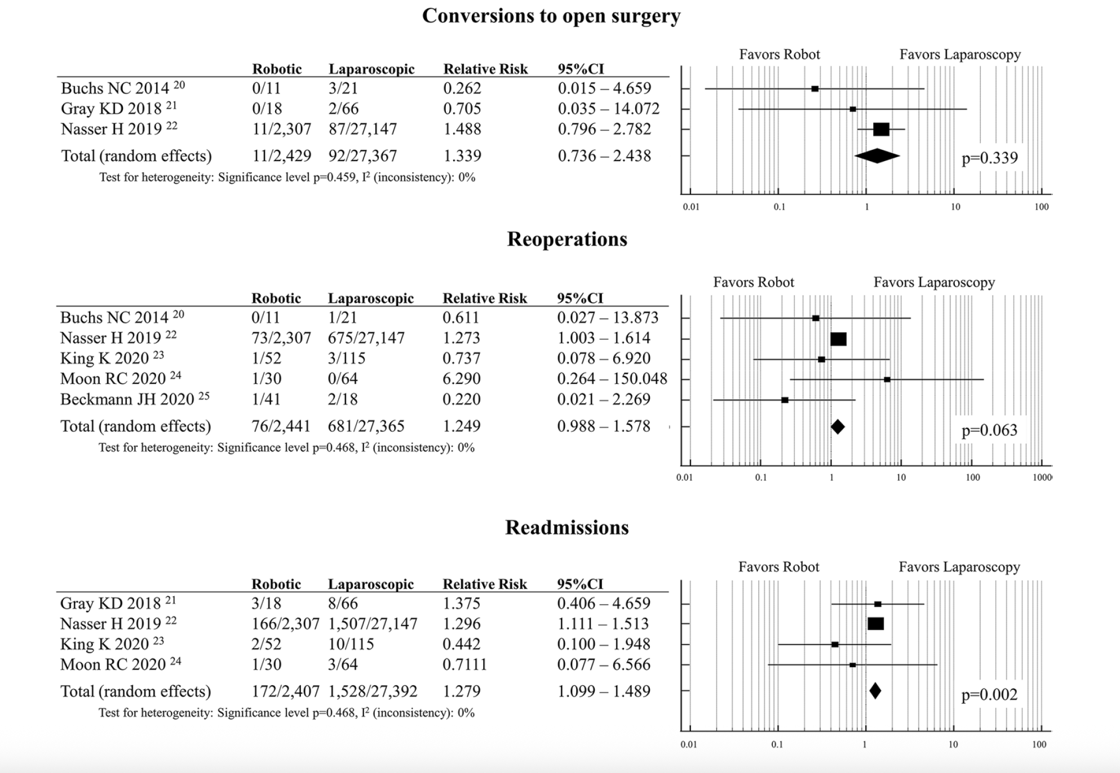

Slide 14
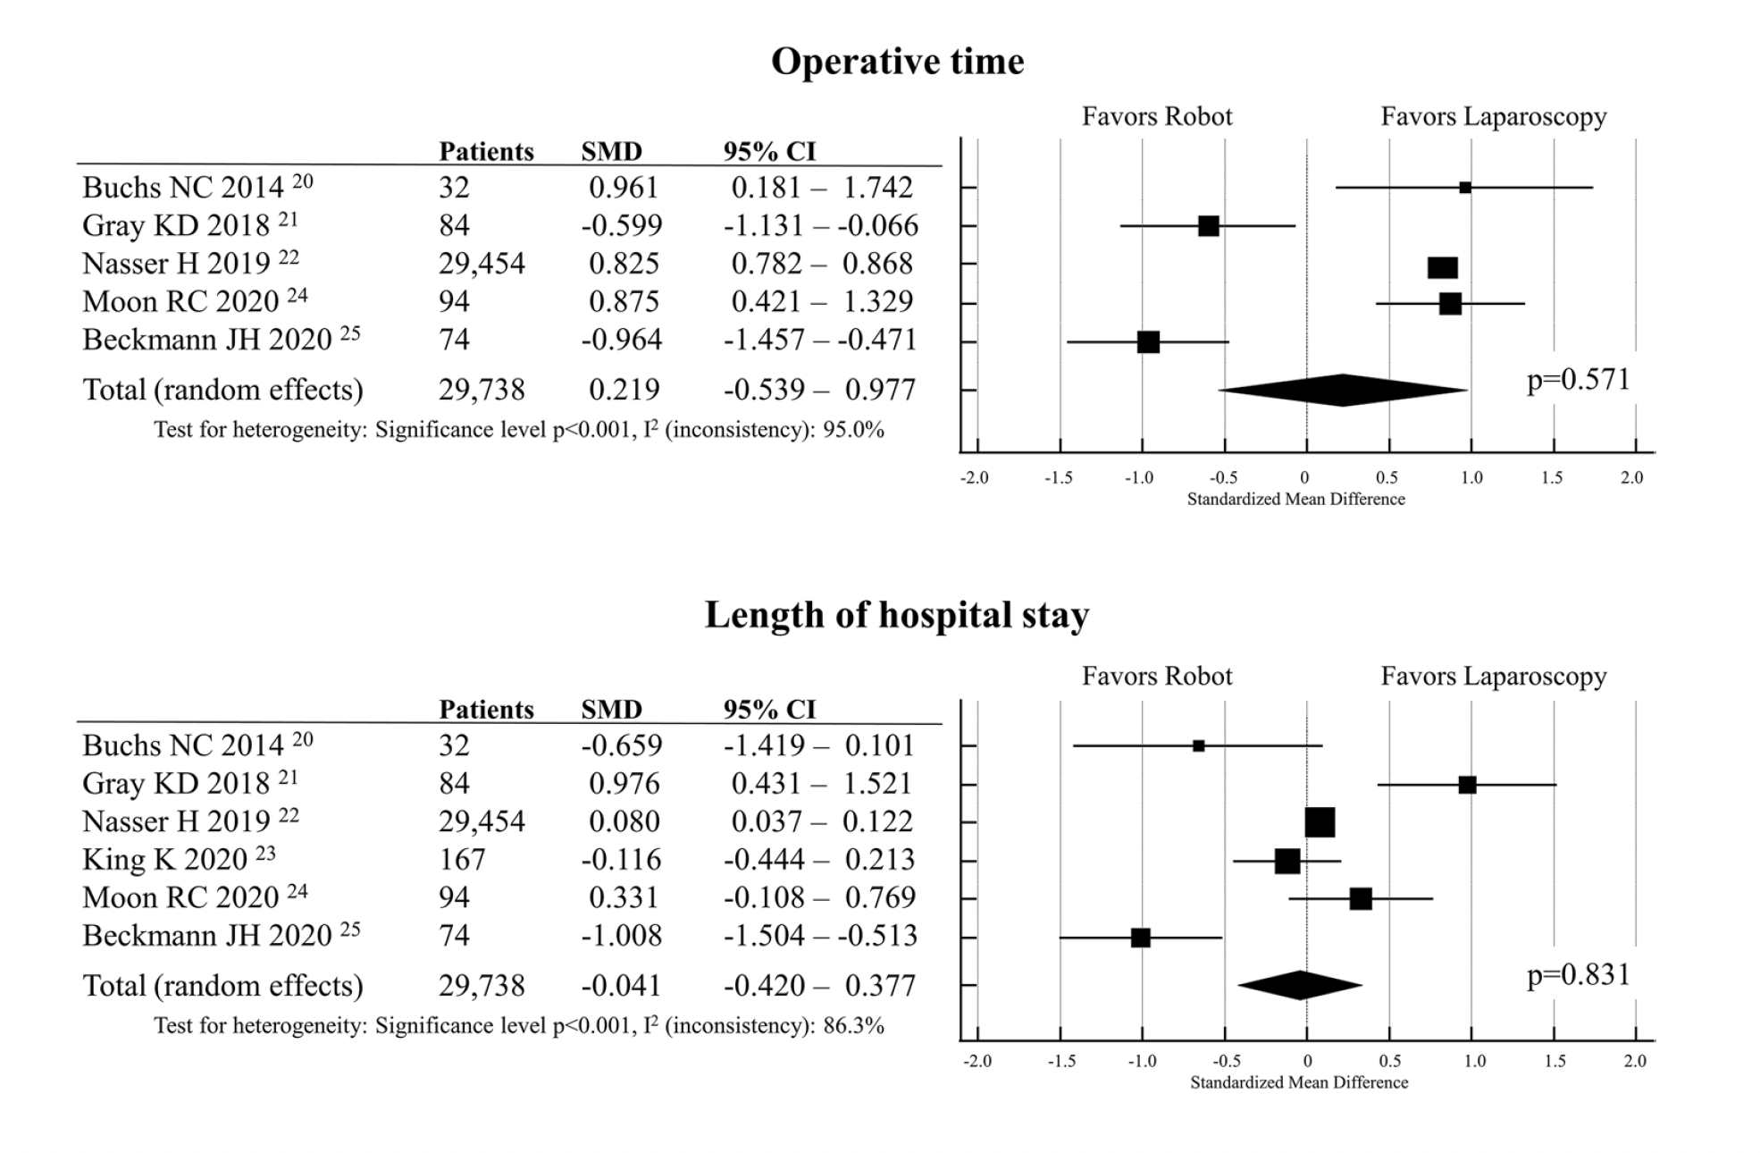

Slide 15
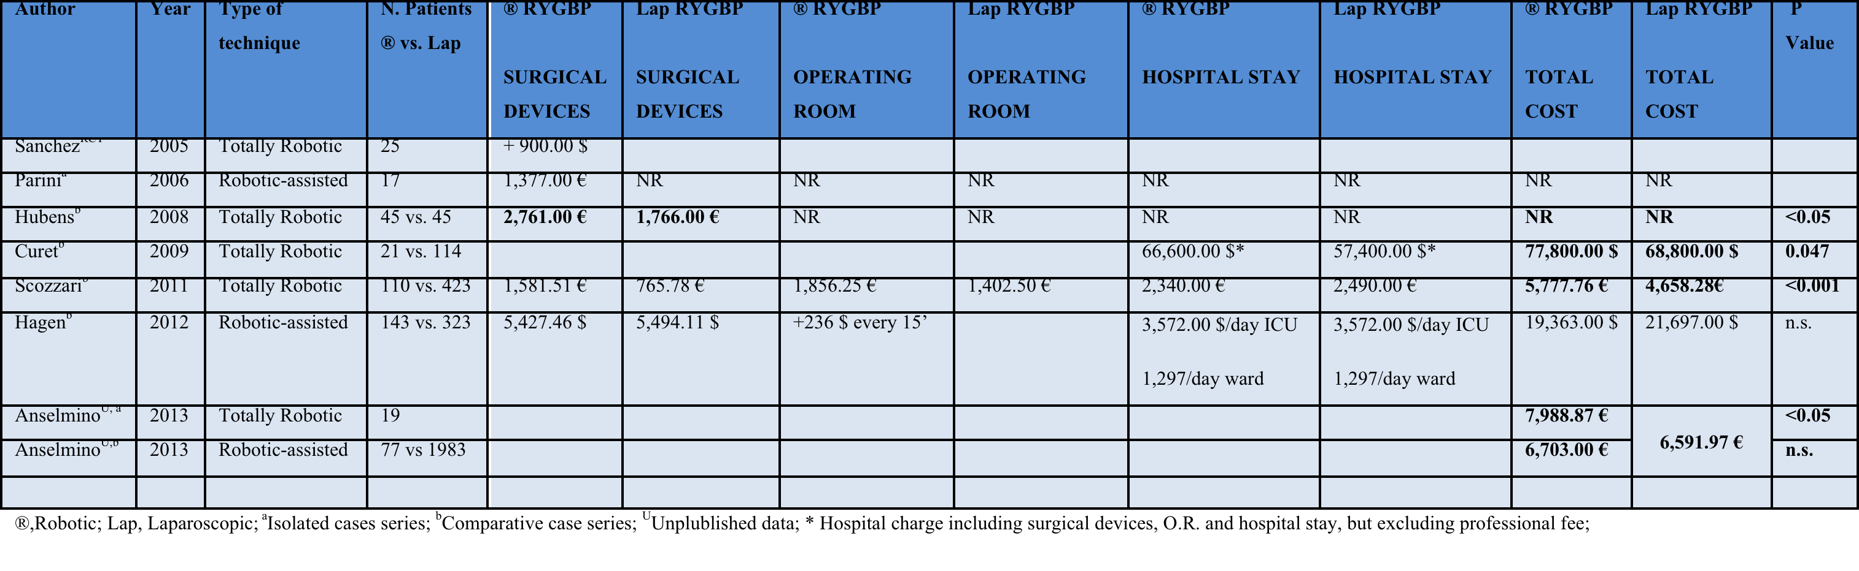
Totally Robotic / Robotic-assisted
vs.
Laparoscopic Roux-en-Y Gastric Bypass
Healthcare Costs
288 DRG = 5.681 € reimbursement
+ 2.307,87 € for TR-RYGP
+ 1.022,00 € for RA-RYGP
No robotic staplers

Slide 16
Robotic Gastric By-pass: Pro & Cons
Conclusions I
Results Analysis
Similar anastomotic rate
More anastomotic strictures in lap group
Similar post-op complications
Similar operation time
Similar lenght of stay
More re-admission in the robotic group for revisional
Bias:
- 1 only RCT with big bias (too many stapled anastomoses in the lap group)
- most retrospective
- some multicentric
- not comparable numbers between lap and rob groups
- mixture of totally robotic with robotic assisted
- mixture of sutured and stapled anastomoses
- no data on surgeons experience (learning curve)

Slide 17





Robotic Gastric By-pass: Pro & Cons
Conclusions II
Wise and not indiscrimanate use of Robotic Platform in Bariatrics
Advantages
3D full HD view
Articulating Endo-wrist instruments
Comfortable surgeon’s position (no tremor)
Accurate tissue dissection
Precise hand-sewn
Telesurgery
Double consolle (proctoring, tutoring)
Disadvantages
Dedicated Operating theatre
Docking time
Need to dock and undock to allow staplers insertion
4-arms maximum (need extra trocar/s)
Need assistant surgeon
High costs

